Slide 1
Deep Learning: Identify painter from painting
Gabriele Omari
Statistical Machine Learning
19/02/2020

Slide 2
Problem:
Supervised Classification Problem:
given a painting, recognize the painter
Pros:
Not a negligible number of paintings (~8500)
Cons:
Not an easy task, due to painters belonging to many different art movements (e.g. from Renaissance to Surrealism)

Slide 3
Dataset:
Source: Best Artworks of All Time
50 painters
8446 paintings
Implementation details:
RGB images with variable size -> resized to (3,331,331)
Batch size: 32
No data augmentation

Slide 4
Some painters:
Name | Years | Genre | Nationality | Paintings
Amedeo Modigliani | 1884 - 1920 | Expressionism | Italian | 193
Vasiliy Kandinskiy | 1866 - 1944 | Expressionism,Abstractionism | Russian | 88
Diego Rivera | 1886 - 1957 | Social Realism,Muralism | Mexican | 70
Claude Monet | 1840 - 1926 | Impressionism | French | 73
Rene Magritte | 1898 - 1967 | Surrealism,Impressionism | Belgian | 194
Salvador Dali | 1904 - 1989 | Surrealism | Spanish | 139
Edouard Manet | 1832 - 1883 | Realism,Impressionism | French | 90
Andrei Rublev | 1360 - 1430 | Byzantine Art | Russian | 99
Vincent van Gogh | 1853 – 1890 | Post-Impressionism | Dutch | 877

Slide 5
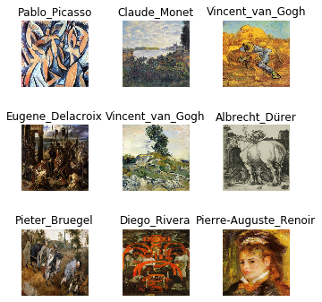
Some paintings:

Slide 6
Approach:
Convolutional Neural Networks:
Densenet 201
Resnet 152
Deep Learning Framework:
fast.ai, due to overperformance w.r.t Keras

Slide 7
Methodology:
Dataset Split:
Training Set: 90%
Validation Set: 10%
Transfer Learning & Fine tuning:
ImageNet pretrained weights
1 Cycle Policy & Differential Learning Rate

Slide 8
Results:
Densenet 201:
accuracy: 0.8649
top_k_accuracy: 0.9751
Resnet 152:
accuracy: 0.8237
top_k_accuracy: 0.9556

Slide 9
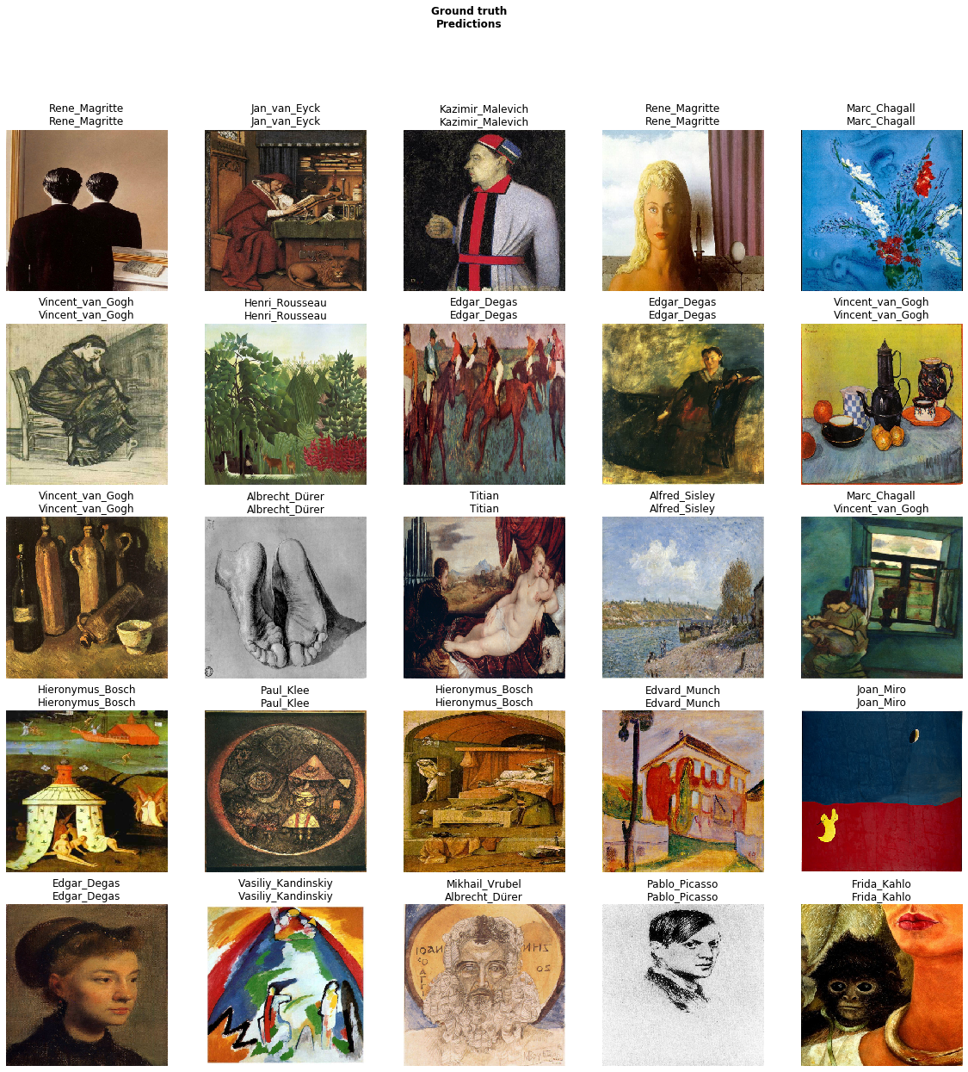
Densenet 201:

Slide 10
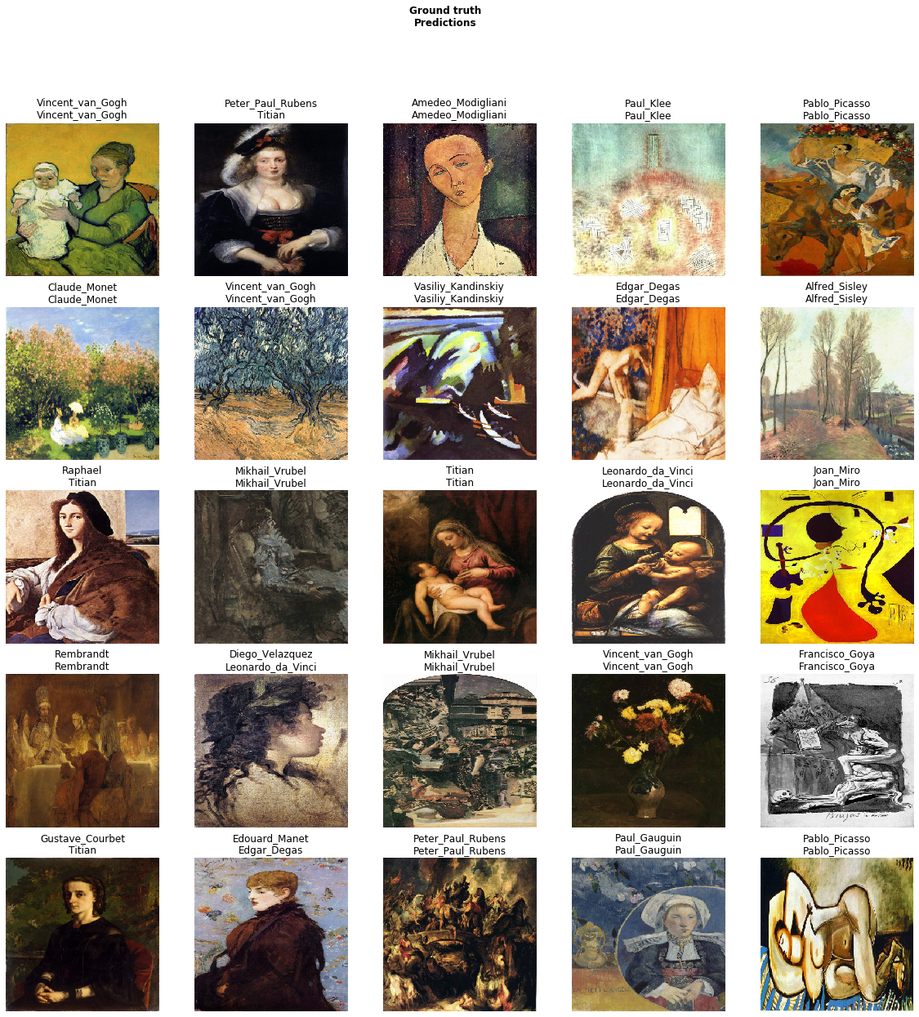
Resnet 152:

Slide 11
Bibliography & References:
Deep Residual Learning for Image Recognition
Densely Connected Convolutional Networks
Best Artworks of All Time
fast.ai

